Slide 1
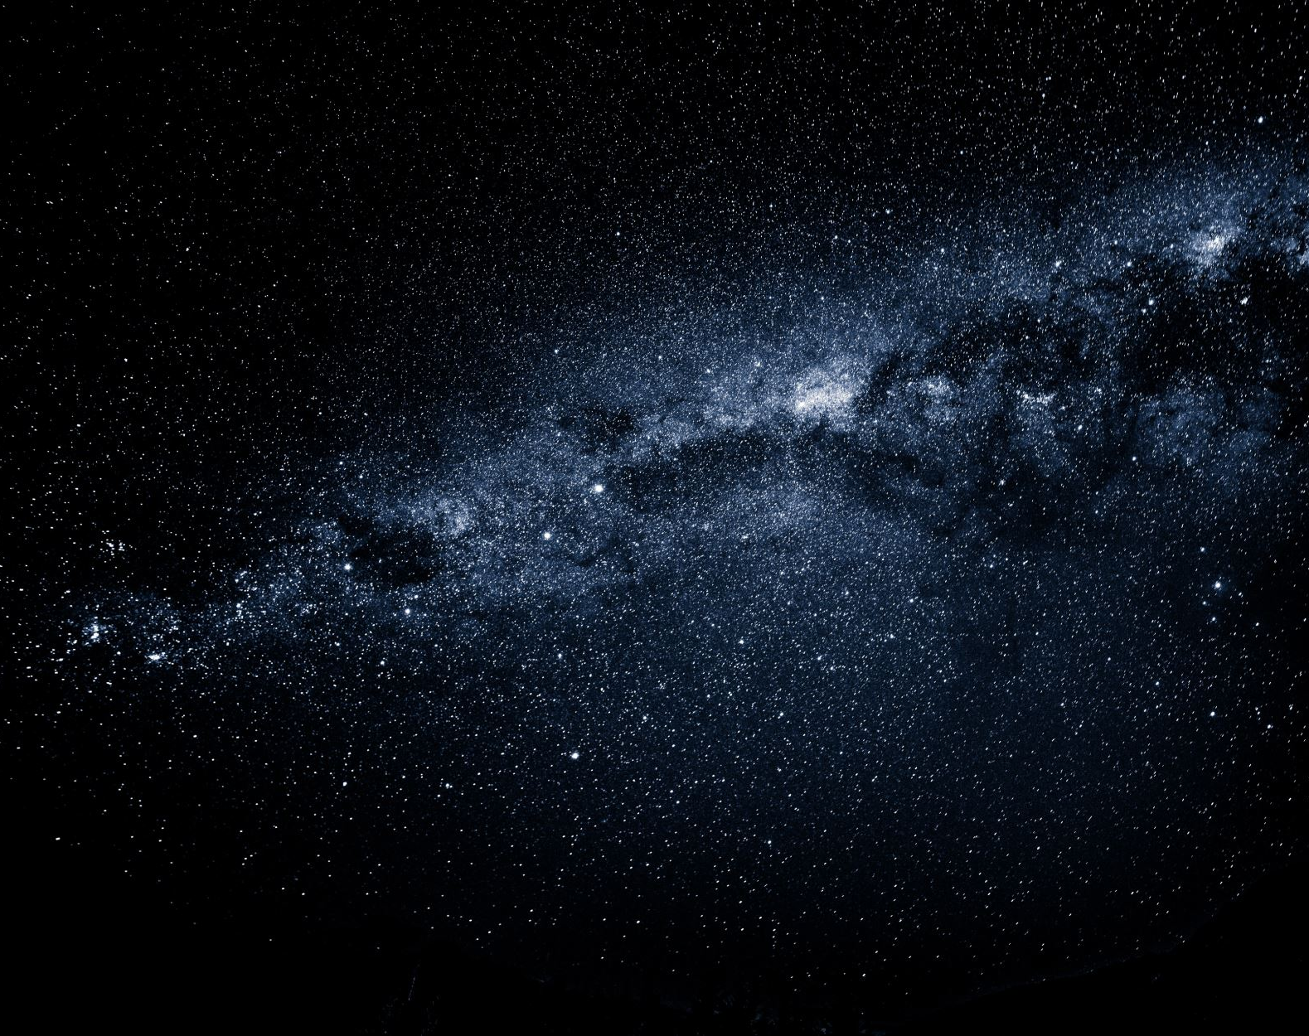
Optical Character Recognition (OCR) Pipeline for Image Analysis Paarth Sahni

Slide 2
Project Overview
Objective:
-Develop an OCR pipeline to process images, extract text, and analyze object attributes.
Dataset:
Synthetic text images, segmented objects, and metadata.
Tools Used:
TensorFlow for model development
OpenCV and PIL for image processing
Streamlit for UI testing
Image/Graphic:
High-level flowchart of the pipeline or a sample image from the dataset.

Slide 3
Implementation
1. Data Preparation:
- Loaded and preprocessed image data and labels.
- Split dataset into training and validation sets.
2. Model Development:
- Built and trained an OCR model using TensorFlow.
- Implemented image segmentation and text extraction.
3. Data Mapping:
- Extracted and mapped text data to object attributes.
- Created a mapping of object IDs, descriptions, and extracted text.
4. UI Development:
- Developed a Streamlit app to interact with the OCR model and visualize results.
Image/Graphic:
- Example code snippets or screenshots of the model architecture and UI.

Slide 4
Conclusion & Future Work
Conclusion:
- Successful implementation of the OCR pipeline.
- Achieved accurate text extraction and object analysis.
Future Work:
- Explore more advanced models and techniques.
- Enhance UI features for better user experience.
- Expand dataset for broader applicability.

